Slide 1


Regression Analysis
PlayDo Electronic Company

Slide 2
Linear and Multiple Regression Analysis

Slide 3
Executive Summary
We address the significance of daily purchasers on the revenue generated from those purchasers on a daily basis. We would like to test the level of impact daily purchasers and number of products purchased have on the revenue generated from those purchasers on a daily basis.
Highlights
There’s a strong relationship between Dependent and Independent Variable of the linear regression model.
The Independent Variables (number of transactions per customer and Email Interractions) have a strong relationship with the Revenue generated from those purchasers on a daily basis.
Both regression models have and R-squared score of roughly .9 which shows strong significance.
Recommendation
Measures should be taken to maintain and increase email interractions, leading to greater number of daily purchasers, hence boosting revenue.

Slide 4
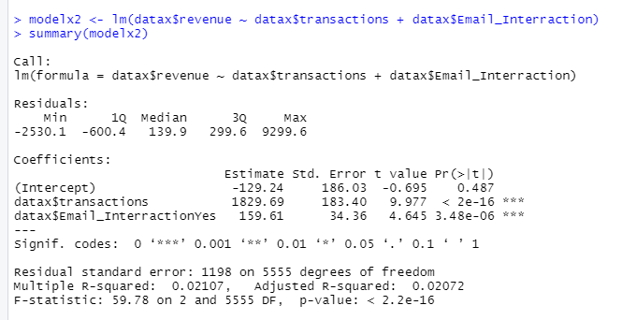
Regression model
This multiple regression model is valid because there’s a strong relationship between the number of transactions per customer, Email Interractions and the revenue generated from those purchasers on a daily basis. The R-squared value gets us a value of ~.98

Slide 5
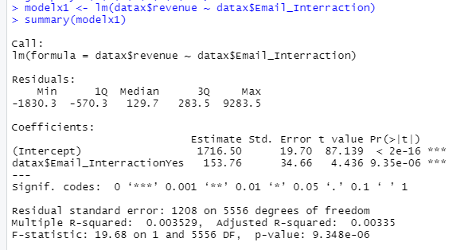
Regression model
This linear regression model is valid because there’s a strong relationship between the ratio of email interractions and the revenue generated. The R-squared value gets us a value of ~.99

Slide 6
Summary
There’s a strong relationship between Dependent and Independent Variable of the linear regression model.
The Independent Variables (number of transactions per customer and Email Interractions) have a strong relationship with the Revenue generated from those purchasers on a daily basis.
Both regression models have and R-squared score of roughly .9 which shows strong significance.

Slide 7
Recommendation
Measures should be taken to maintain and increase email interractions, leading to greater number of daily purchasers, hence boosting revenue.

